Slide 1
Microsoft Project 2010 – Introduction, Part 4
Phil Pfeiffer
Fall, 2014

Slide 2
This Presentation's Structure
Part 1
Common features & their uses
Gantt Chart View
Tasks
Scheduling Modes: Manual Mode
Inter-Task Dependencies
Resources
Other operations on tasks
Part 2
Common features, uses (cont.)
Overallocation
Duration, Units, Work
Scheduling Modes: Auto Scheduling
Scheduling Modes: Recommendations
Part 3
Common features, uses (cont.)
Summary tasks and subtasks
Summary Tasks: Auto Scheduling
Summary Tasks: Inter-Task Dependencies
Calendars
Calendar Management
Part 4
Common features, uses (cont.)
Calendar Management (cont.)
Modifying Calendars
Skewed Calendars
Calendar Architectures
Project Tracking
Key limitations and gotchas

Slide 3
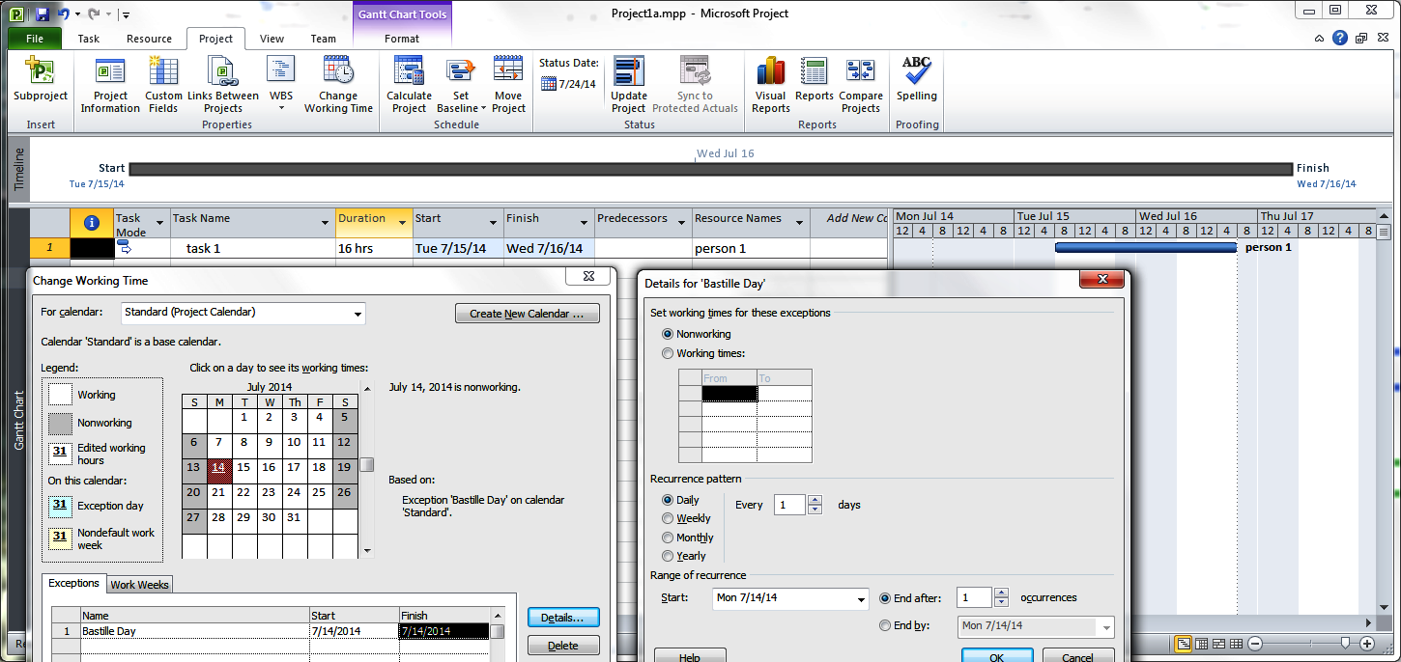
Calendar Management (Project)
The project shown here pairs
task 1 with no calendar and
person 1 and the project as a whole with Standard
Standard has been modified, using the Change Working Time / Exceptions tab, to treat Bastille Day (14 July 2014) as a full holiday.
Note that treating 14 July 2014 as a holiday causes Project to shift the schedule from 14-15 July to 15-16 July.

Slide 4
Calendar Management (Project)
Closeups of the Change Working Time / Exceptions and Details menus. The Details menu was opened by clicking on the Change Working Time menu's Details… control.

Slide 5
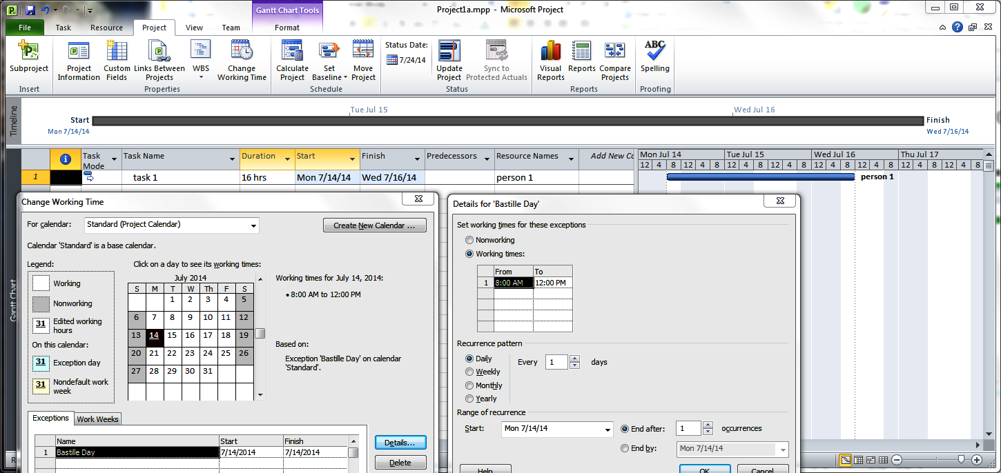
Calendar Management (Project)
The project shown here pairs
task 1 with no calendar and
person 1 and the project as a whole with Standard
Standard has been modified, using the Change Working Time / Exceptions tab, to treat Bastille Day (14 July 2014) as a half-day holiday; employees have the afternoon off
Note that treating 14 July 2014 as a half-day holiday causes Project to shift the schedule from 14-15 July to 14 July 8 am – 16 July noon.

Slide 6
Calendar Management (Project)
Closeups of the Change Working Time / Exceptions and Details menus. The Details menu was opened by clicking on the Change Working Time menu's Details… control.

Slide 7
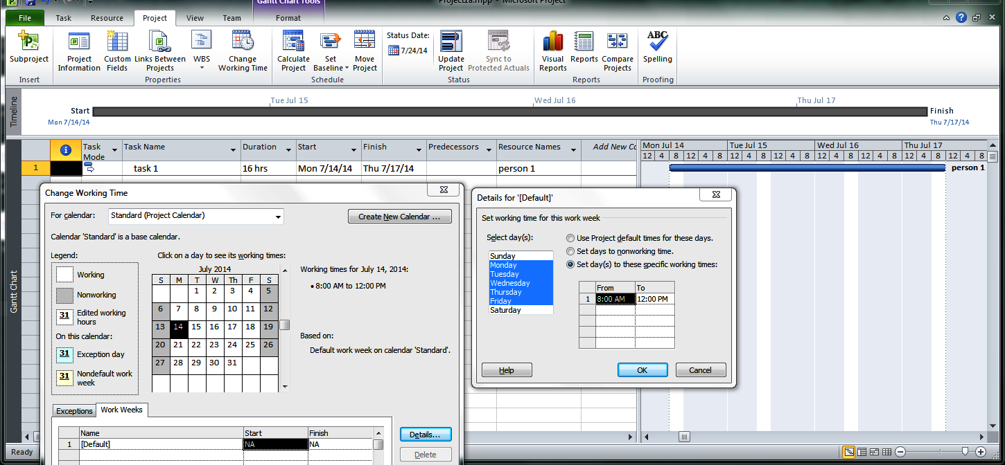
Calendar Management (Project)
The project shown here pairs
task 1 with no calendar and
person 1 and the project as a whole with Standard
Standard has been modified, using the Change Working Time / Work Weeks tab, to treat the default work week as a half-day week; employees have every afternon off
Note that treating work days as half-day holidays causes Project to shift the schedule from 14-15 July to 14-17 July: i.e., 4 hours per day * 4 days = 16 hours

Slide 8
Calendar Management (Project)
Closeups of the Change Working Time / Work Weeks and Details menus. The Work Weeks menu was opened by clicking on the Change Working Time menu's Details… control.

Slide 9
Modifying Calendars: Guidelines
Managing the default work week
The default work week's start and end fields (N/A) can't be changed.
The default work week hours can be changed.
This typically means reducing them: e.g., to 8-11 am and 1-4 pm to account for non-productive overhead in a typical work week
If you need to expand them, Project help guides recommend switching to the 24 hour schedule instead
Managing non-default work weeks
Work week table entries are spans of days - 1000 max for any one entry
A span of days can most easily be specified by
Selecting the span from the calendar above the table
Then entering a name for the block in the Name column
Non-default time frames in the tables can't overlap.
Project 2010 gets quite fussy about this; it won't deselect a work week that overlaps with another work week until you change spans
Managing exceptions
Entries in the exceptions table supersede those in the work week table
Use exceptions for special "events" like holidays and training

Slide 10
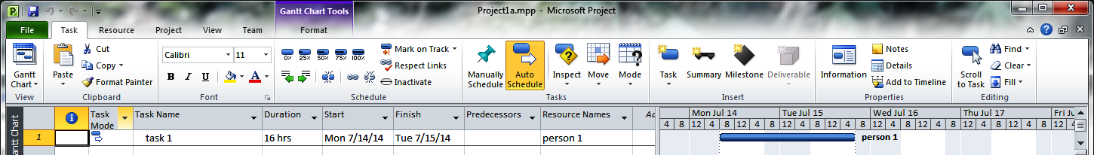
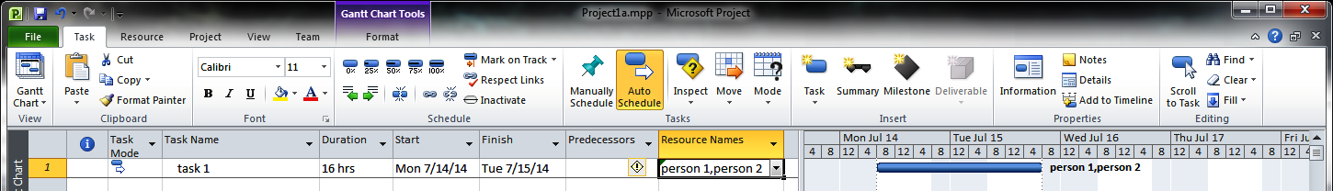
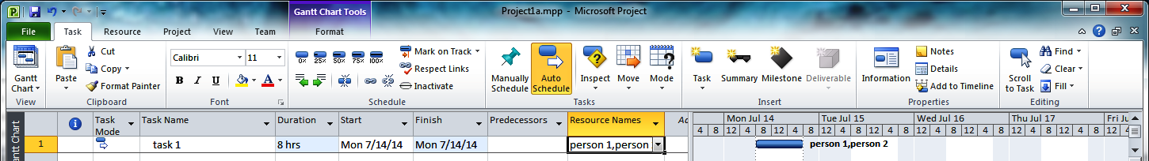
Scheduling with Multiple Resources
Review
Adding a second work resource for a fixed units, non-effort-driven task doubles the work without changing the duration
Selecting the information pop-up option for reduced duration then has the effect of halving the schedule, while keeping work constant

Slide 11
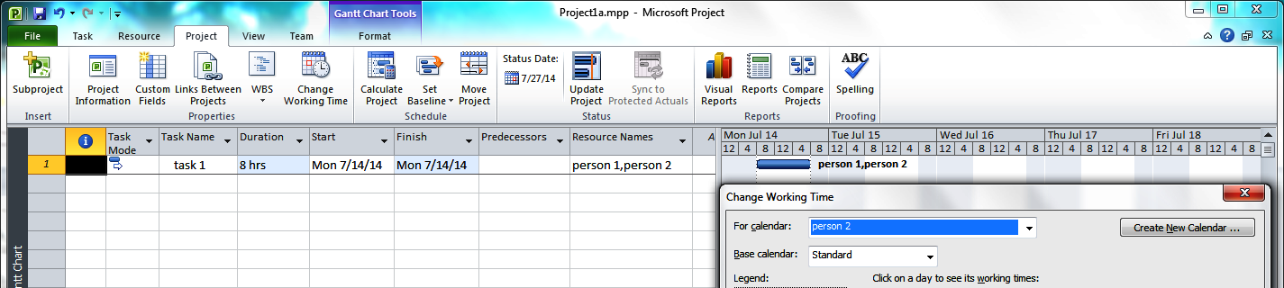
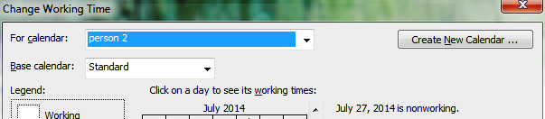
Resource Calendars
Every resource, when first created, gets its own calendar
This calendar can be accessed with the For calendar: dropdown, located in the menu obtained by clicking the Project tab's Change Working Time icon
This calendar
Has the same name as its resource
Inherits its properties from the project calendar in force at the time

Slide 12
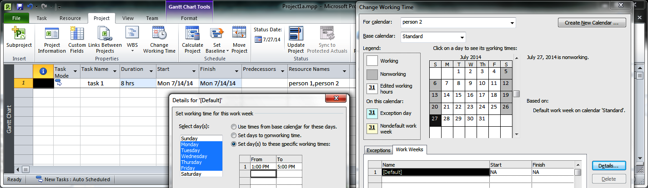
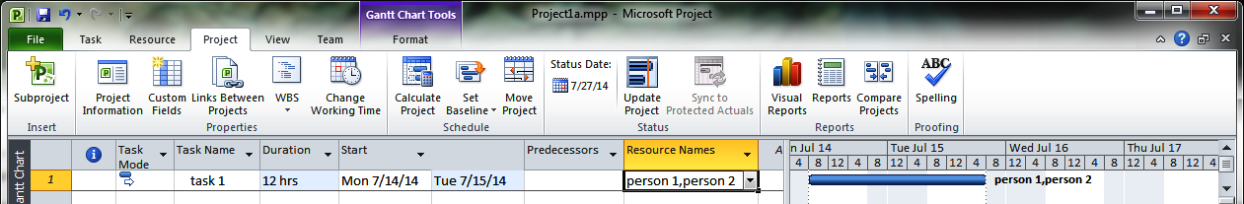
Skewed Resource Calendars
Resource-specific calendars allow working times to be tailored to individual resources
Here, for example, person 2's default work week is set to afternoons only.
The change produces a schedule with a 12-hour duration

Slide 13
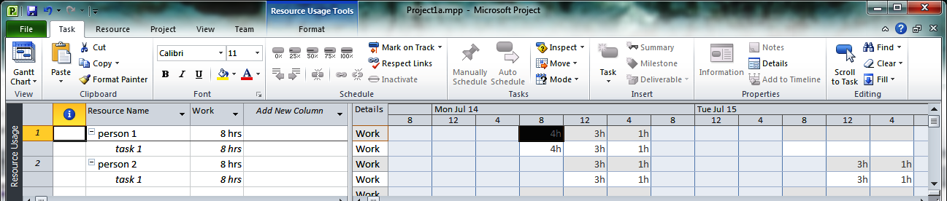
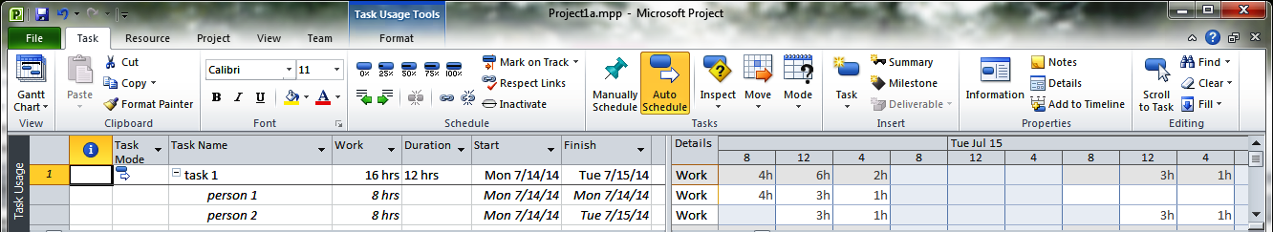
Skewed Resource Calendars
The resource usage and task usage views clarify Project's calculated schedule.
Project assigns the extra work to person 2 rather than person 1, which extends the schedule by 5 hours in real time: i.e.,
if person 1 had been assigned the leftover work after 7/14, the task would have been finished by noon rather than 5 pm.
Project appears to calculate duration from the times when either person 1 or person 2 works on the task. Note that Tuesday am doesn't enter into the duration.

Slide 14
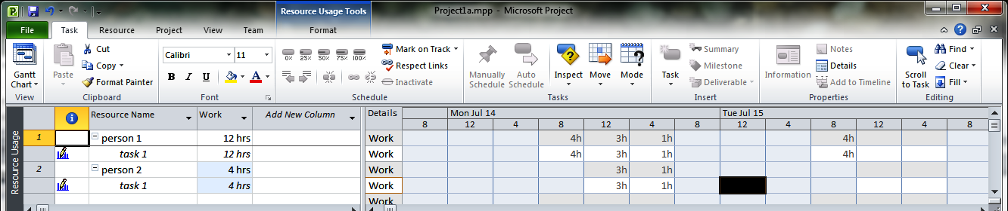
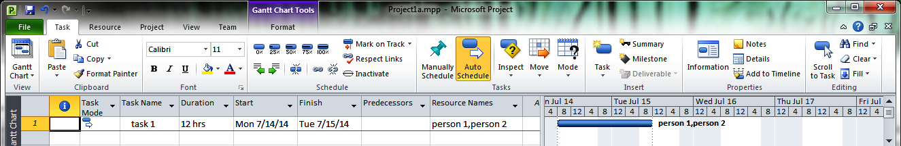
Skewed Resource Calendars
Requesting Fixed Effort scheduling for the Fixed-Units-Scheduled task 1 fails to shift work to person 1. Ditto for requesting Fixed Work scheduling for this task.
A tighter schedule can be obtained by hand-editing Project's schedule. Here, the 15 July allocation of 4h person 2 was deleted and replaced by a 4h, 8am allocation to person 1.
Project flags both resources' schedules as hand edited in the Resource Usage view's information column.

Slide 15
Skewed Resource Calendars
As a rule, I strongly recommend using Project's automated leveling feature instead of doing leveling by hand
Auto leveling is far less error prone
Auto leveling is also far less tedious – particularly for larger, more complex schedules
In this case, however, I can't figure out how to get auto leveling to tighten this schedule
And, for what it's worth, I've seen relatively little detailed documentation on Microsoft's scheduling and leveling algorithms, which I'm guessing are proprietary.

Slide 16
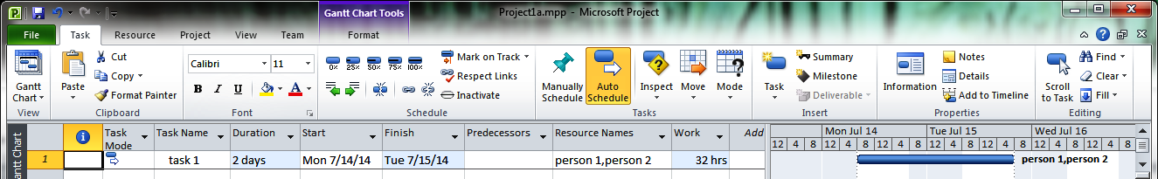
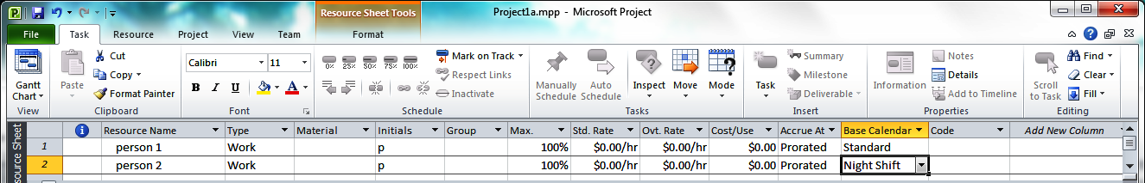
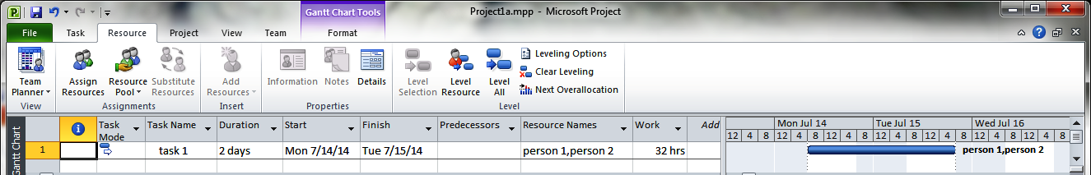
Skewed Resource Calendars, Different Bases
This series of examples starts with a two-person, 2-day-long task.
Initially, persons 1 and 2 are scheduled according to Project's Standard schedule.
If person 2's base schedule is changed to Night Shift to expedite the project …
….Nothing changes.

Slide 17
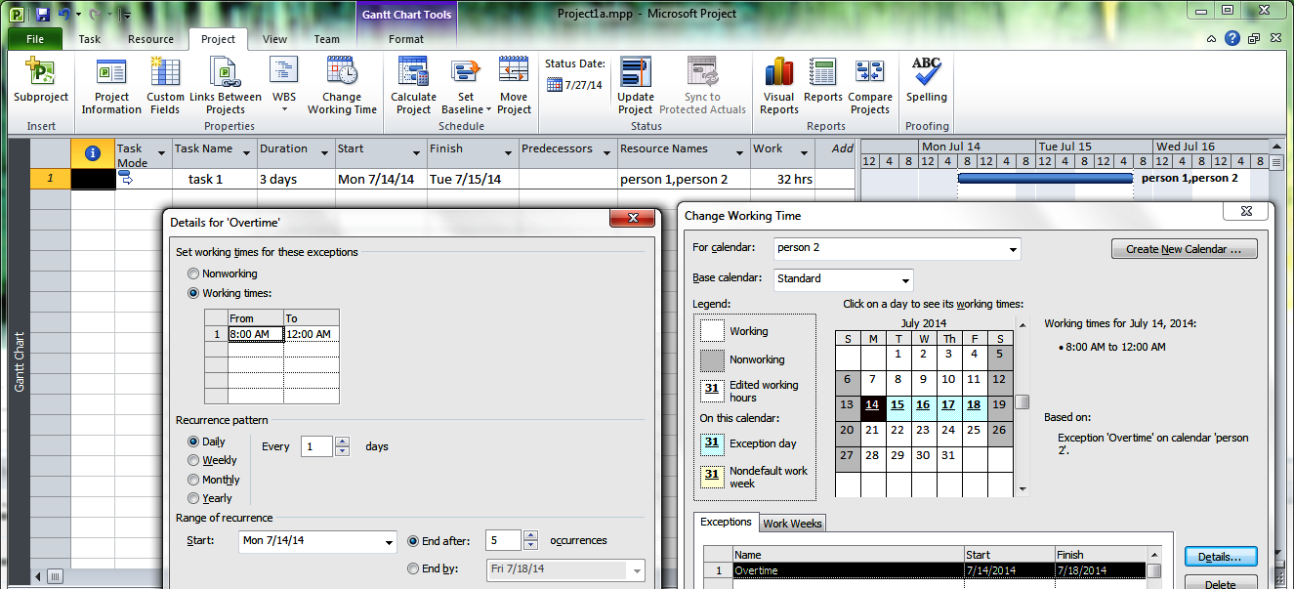
Skewed Resource Calendars, Same Bases
Another strategy for accelerating the schedule sets person 2's
Base calendar to Standard and
Working hours for 14-18 to 8 am to 12 am (i.e., midnight)

Slide 18
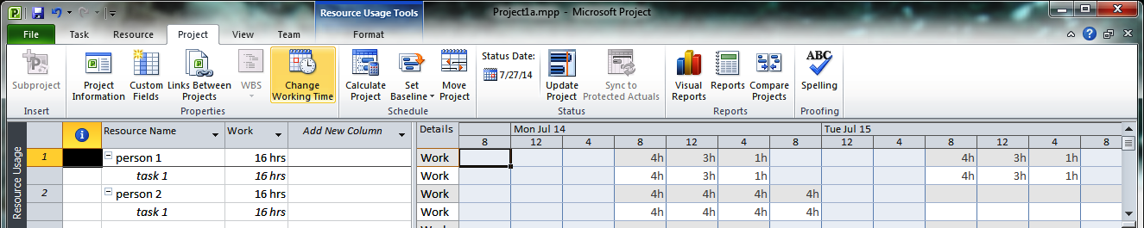
Skewed Resource Calendars, Same Bases
This attempt at schedule adjustment works well, at first glance
person 2 is now scheduled to work from 5 pm until 12 midnight
person 1 now picks up the 8 leftover hours on 15 July
Splitting the work on 15 July would accelerate termination by 4 hours
However, I can't get Project to level in increments of less than 1 day
… even though the leveling options for
adjusting individual assignments in tasks and
creating splits in remaining work
are enabled by default (see Resource / Leveling Options control)
Worse, this strategy breaks down in the presence of summary tasks

Slide 19
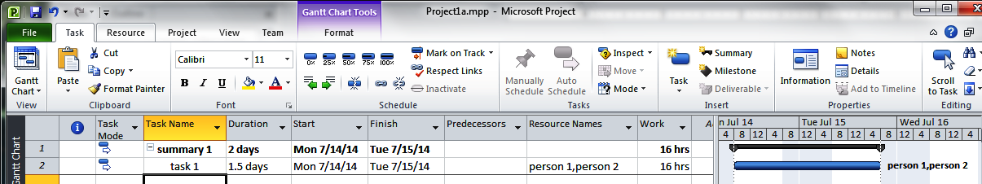
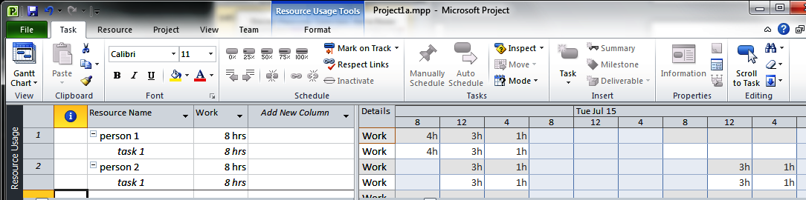
Skewed Resource Calendars, Same Bases
Making task 1 a subtask of a summary task subjects task 1 to the summary task's schedule, causing Project to ignore person 2's 5 pm – midnight work schedule
This is because summary 1, when created, inherited the project's main schedule
… and the project's main schedule, Standard, excludes evening hours

Slide 20
Working with Multiple Calendars: Advice
Adapt your use of calendars to Project's limitations: i.e., for every project,
Define one main calendar
Assure that the main calendar's hours encompass all possible working times
If any project work can be scheduled for a given day at a given time, that day and time should be treated as work time in the main calendar
Assure that every work resource uses this main calendar as its base calendar
Benefits: this strategy
allows Project's leveling algorithm to work effectively, but
limits a project plan to a two-level architecture for calendar representation
Problems: this strategy
makes it impossible to frame "mid-level" scheduling policies for projects with different groups of workers who work different sets of hours

Slide 21
Why Three-Level Calendars Are Ineffective
Ideally, MS Project should allow group-specific scheduling constraints to be factored into mid-level group-specific calendars: e.g.,
Main: working days run from 8 am until midnight
Group 1: working days run from 8 am until 5 pm, with a noontime break
Person 1 has a group 1 schedule, with a vacation during July
Person 2 has a group 1 schedule, with a vacation during August
Group 2: working days run from 3 pm until midnight, with a 7 pm break
Person 3 has a group 2 schedule, with a vacation during September
Person 4 has a group 2 schedule, with a vacation during October
This architecture would allow each group's calendar – e.g., holidays, working hours – to be adjusted
in one menu
independently of all other groups' calendars
Unfortunately, Project only schedules task relative to one base calendar. This effectively prevents the mixing of workers from multiple groups: e.g.,
if task 1's base calendar is the group 1 calendar, then group 2 will be scheduled according to the group 1 calendar (and similarly for group 2)
if task 1's base calendar is main, then group 1 and group 2 will be scheduled against main rather than their respective base calendars

Slide 22
Calendar Architecture and Mid-Level Workgroups
What does work:
Main: working days run from 8 am until midnight
Person 1 works from 8-5 with noon lunch and a vacation during July
Person 2 works from 8-5 with noon lunch and a vacation during August
Person 3 works from 3-midnight with 7pm break and a vacation during July
Person 4 works from 3-midnight with 7pm break and a vacation during August
Problem: maintenance overhead created by violating the DRY ("don't repeat yourself") principle of logic design: e.g.,
To change group 1's workdays from 8-5 to 7-4, person 1 and person 2's work week specifications must both be changed
To add Bastille Day as a holiday for group 2, person 3 and person 4's work week specifications must both be changed
What happens when projects are tracking groups of, say, 10-20 employees who are all working different schedules?
I see
no simple workaround for the need to maintain these calendars in parallel
no workaround at all, short of writing code to automate the updates

Slide 23
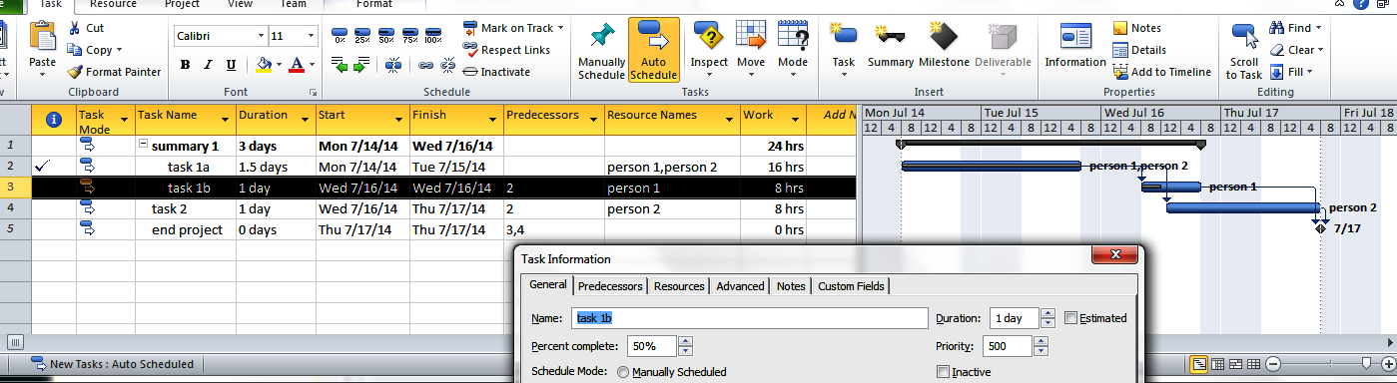
Project Tracking
Project's Task Information menu is activated by right-clicking on a task, then selecting "Task Information" from the resultant dropdown menu
The menu has a field, Percent complete, which can be set to the percentage of work completed for a given task
Also, the Task tab's Schedule section has shortcut icons for setting a task's completion percentage to 0%, 25%, 50%, 75%, or 100%
Here, task 1a's and task 1b's percent complete fields have been set to 100% and 50%, respectively.
Note that Project puts a check mark in the ⓘ field for completed tasks.

Slide 24
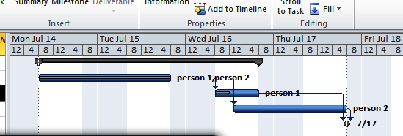
Project Tracking
A project's Gantt Chart view indicates completion percentages for individual tasks with red bars. These red bars are embedded in the blue bars that show tasks' scheduled timelines.
Here, task 1a's and task 1b's percent complete fields have been set to 100% and 50%, respectively.
Note that task 1a's and task 1b's embedded bars span all and part of those tasks' blue bars, respectively.
Note that task 2, which hasn't been started, has a totally blue bar

Slide 25
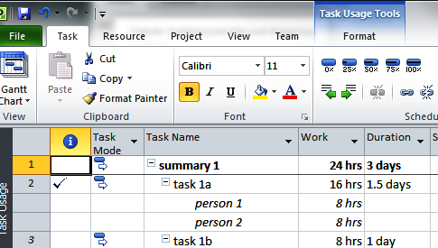
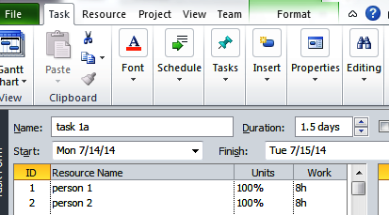
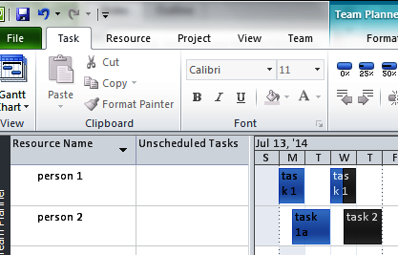
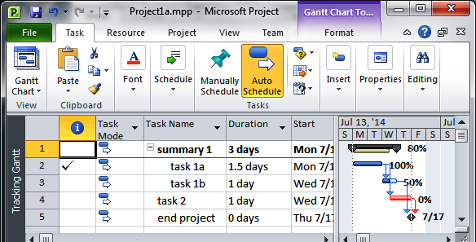
Other views that indicate project progress include
The Task Usage view, which shows check marks next to completed tasks
The Task Form view, which shows work relative to individual project tasks
The Team Planner view, which shows completed work relative to work resources
The Tracking Gantt view, which shows task bars with percent completion

Slide 26
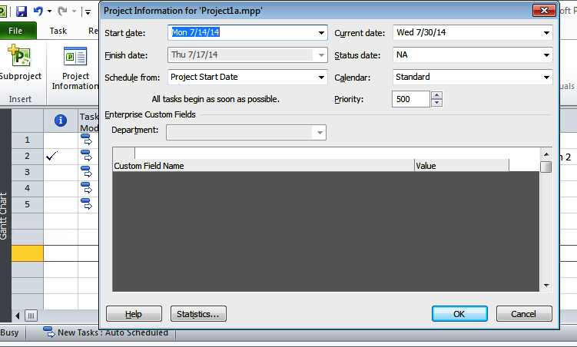
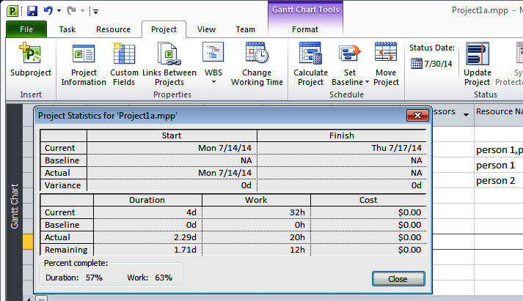
Project Tracking
Selecting the Project Tab's Project Information icon accesses a project's Project Information menu.
Selecting this menu's Statistics… control produces a summary statistics table – the same table obtained via the File tab's Project Information dropdown

Slide 27
Project Tracking
Quite a few of the Task View's columns are concerned with tracking project progress, including
costs: actual to date, projected, and relative to a baseline cost
duration: actual to date, projected, and relative to a baseline duration
start date: actual to date and relative to a baseline start date
finish date: actual to date, projected, and relative to a baselined finish date
various metrics for gauging the relationship between baselined and actual progress
These considerations are beyond the scope of this slide deck

Slide 28


Limitations and Gotchas

Slide 29
No "True" Support for DRY Task Definition
"DRY" – don't repeat yourself
Problem – lack of subprocedures
A task that must be done k times must be copied into schedule k times
This is seriously bad
Changes to one instance of a task requires changes to all for consistency
Can't use subprojects as workaround, since subprojects may only be included once
Could in theory be finessed with macros
This, however, would be clumsy to implement

Slide 30
No "True" Support for DRY Calendar Definition
Described earlier in slides
This is also seriously bad – for complex projects
Problem – lack of "calendar inheritance"
In earlier examples, it should be possible to schedule
person 1, qualified by the main, group 1, and person 1 calendars applied in succession
when
the main calendar is specified as the base calendar for the group 1 and group 2 calendars
the group 1 calendar is specified as the base calendar for the person 1 and 2 calendars
the group 2 calendar is specified as the base calendar for the person 3 and 4 calendars
Again, could in theory be finessed with macros
This, however, would be clumsy to implement

Slide 31
Limited Support for Summary Statistics
Can't compose queries that retrieve (e.g.)
average task time
longest task
most deeply nested tasks
all tasks with a custom field with a given value
Can work around this by (e.g.)
exporting to XML
using XML query language, XQuery, to generate summary statistics
Hope to show some such queries this fall

Slide 32
Weak Support for Contingency Planning
From what I can tell, MS Project can't be used to
specify three-point estimates
Biafore, "MS Project 2010: Missing Manual", p. 107 shows a schedule with "Best, Probable, and Worst" columns
These columns, however, are apparently user-managed comment (i.e., text) columns that are ignored for scheduling
specify that one task should only be triggered if another fails or succeeds
You can, however,
copy a plan and tinker with the copy (recommended by Biafore)
inactivate and reactivate tasks
this would allow for the creation of a worst-case WBS, then the subsequent marking of unneeded tasks as inactive

Slide 33
Weak Support for Relative Constraints
Can't constrain one task to start or finish within a given time relative to start or finish time for second
Example: cooler must be loaded into car within an hour of packing it
Best that I've figured out
Use start-start or finish-finish dependencies
Use guestimated lead-lag times to adjust start time or end time of dependent task
Example: start-start dependency between packing cooler, loading car with 15 minute lag on loading (assuming, say, 15 minutes to load cooler)

Slide 34
Scheduling Intelligence Sometimes an Issue
Slides show schedules where leveling doesn't level task assignments to (e.g.) the nearest hour
I've seen examples where the reverse is true
"Level all" complains that it can't level some tasks, while
Incrementally rescheduling these tasks resolves overallocation
One point in Project's favor: scheduling is HARD
Example of what theoreticians refer to as NP-Complete problem
"Straightforward" to determine if given schedule is optimal;
Believed, unfortunately, to be exponentially hard to find it

Slide 35
Leveling Can Be Slow
I've run leveling jobs that have taken more than an hour to complete
Leveling large numbers of tasks (> 300) with, say, 12 resources on different work schedules can really tax Project
Recommendations
Avoid Project's option for automatically leveling tasks after every change to schedule (off by default)
If possible, manage small changes to large schedules by limiting leveling to affected resources, tasks
More effective for later in process; less so for early tasks
Find something else to do when running big leveling jobs
Accept that scheduling is just difficult
Be happy that Project is doing it for you

Slide 36
Project's User Interface Is Sometimes Unstable
I've seen content disappear from views, including
Gantt timelines from Gantt views
Task rectangle icons from Team Planner
Fixes
All views with vertical dividers: check position of divider bar between Task Sheet and Gantt Chart – it moves unexpectedly
Team Planner View issues: right-click on timeline headers for time frames for which rectangles have disappeared

Slide 37
Somewhat Unstable Operation
I've seen
task times set to 48+ million minutes
task times drop to 0 minutes
Excel cut-and-paste quit working while using Project to level
crashes
Big leveling jobs seem to be particularly troublesome
Possible fixes
revert project to best previous state
for complex projects, making backup copy before editing can save considerable time
close, restart
worst case: reboot Windows

Slide 38
Assorted Cautions
Task Sheet's Find/Replace controls differ from "normal' MS find/replace features
must specify a column
no support for "find/replace" within a selection
no support for regular-expression-based find/replace
no support for "find/replace" over rolled up tasks
entire task hierarchy must be visible in order to do a complete find/replace on a given search string
Project 2010's Undo/Redo controls are global
undo and redo rewind across multiple sheets

